Slide 1
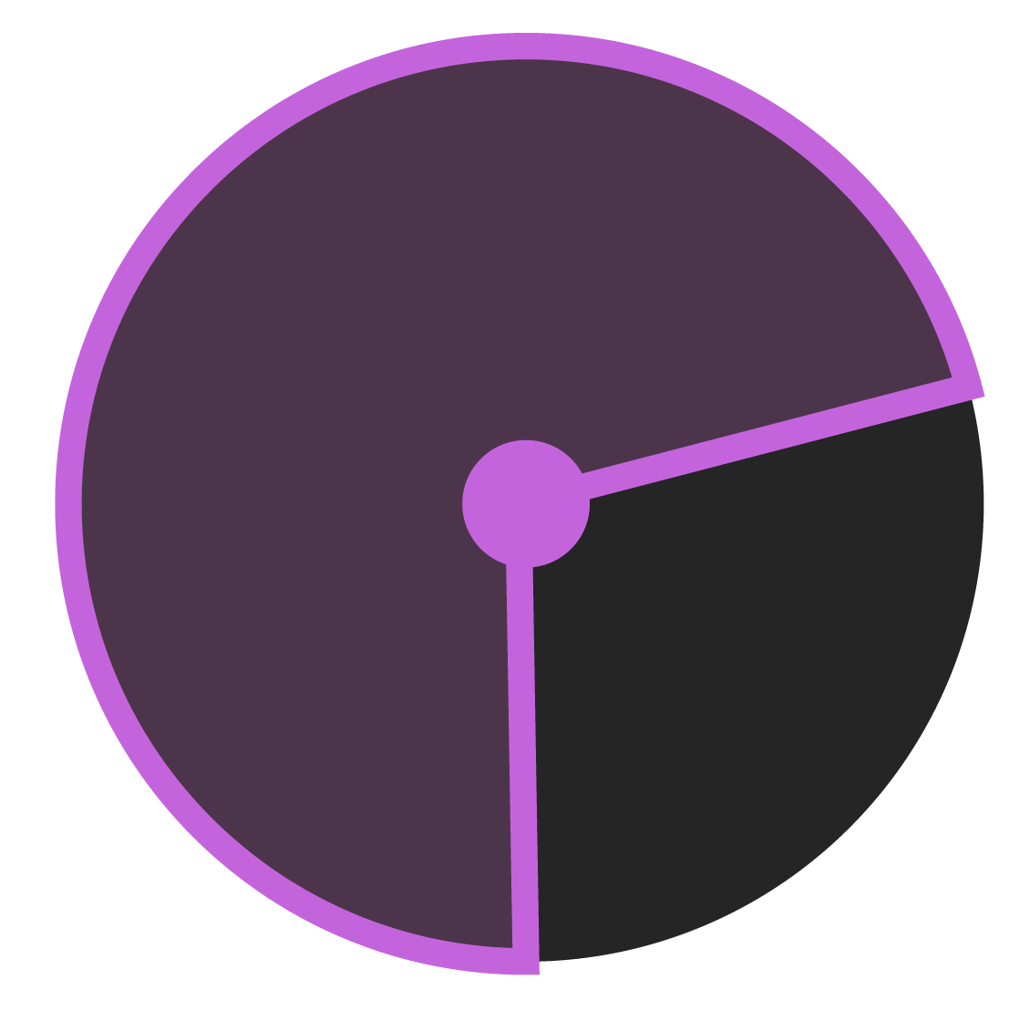
SUBTRACTIVE
SYNTHESIZER
Advanced Coding Tools and methodologies
Natasa Popovic, 991034
Olga Besedova
Andres Bertazzi

Slide 2
THE
GOAL?
Development and implementation of subtractive synthesizer for web browsers
Technologies used :
Javascript
Tone.js
Nexus.js
Final result: user-playable instrument
Interaction types:
Screen keyboard
Computer keyboard
Midi keyboard

Slide 3
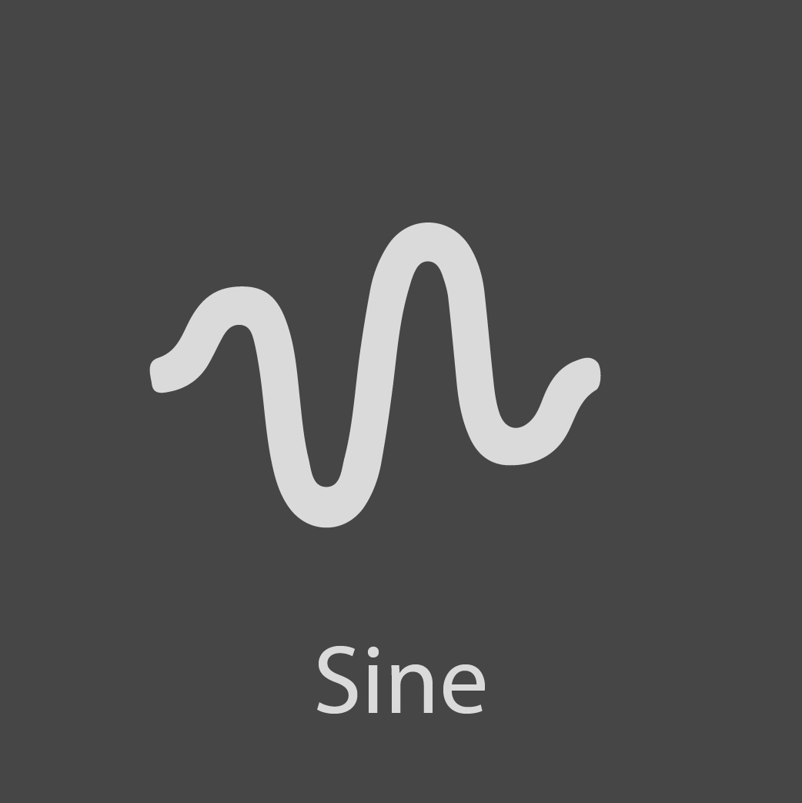
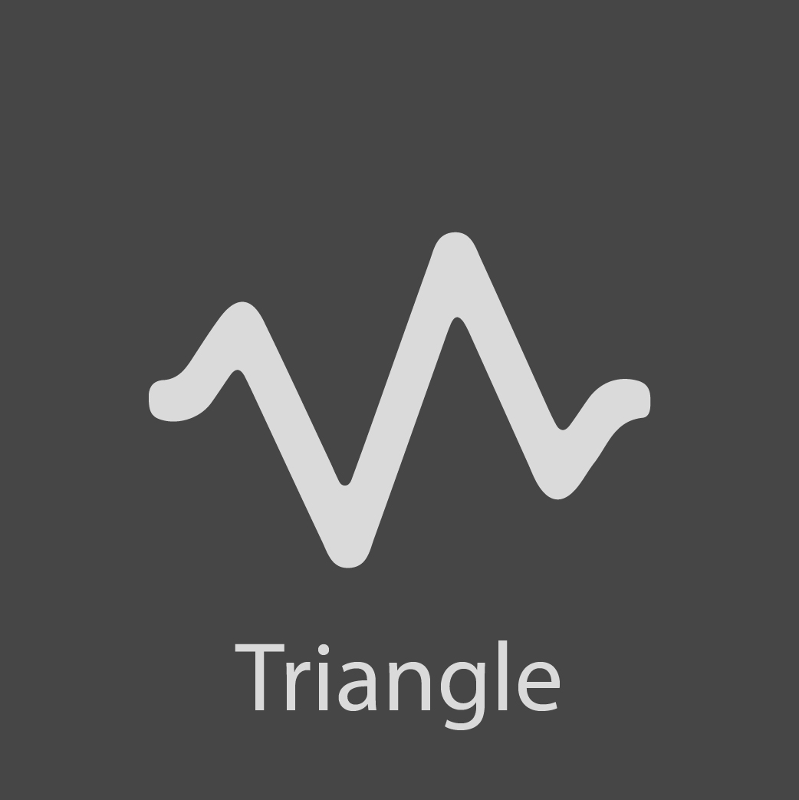
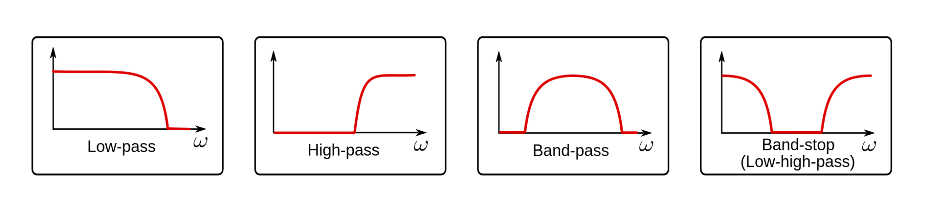
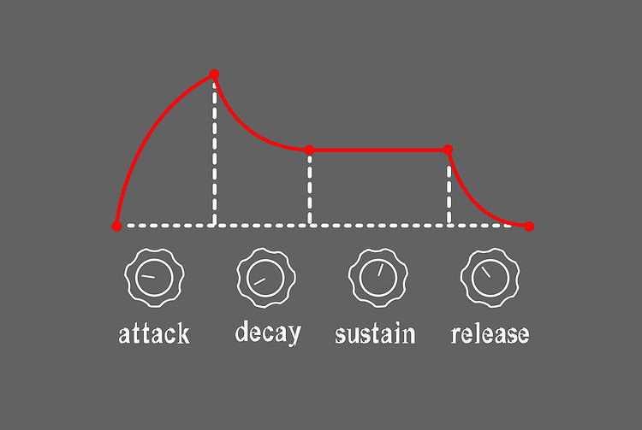
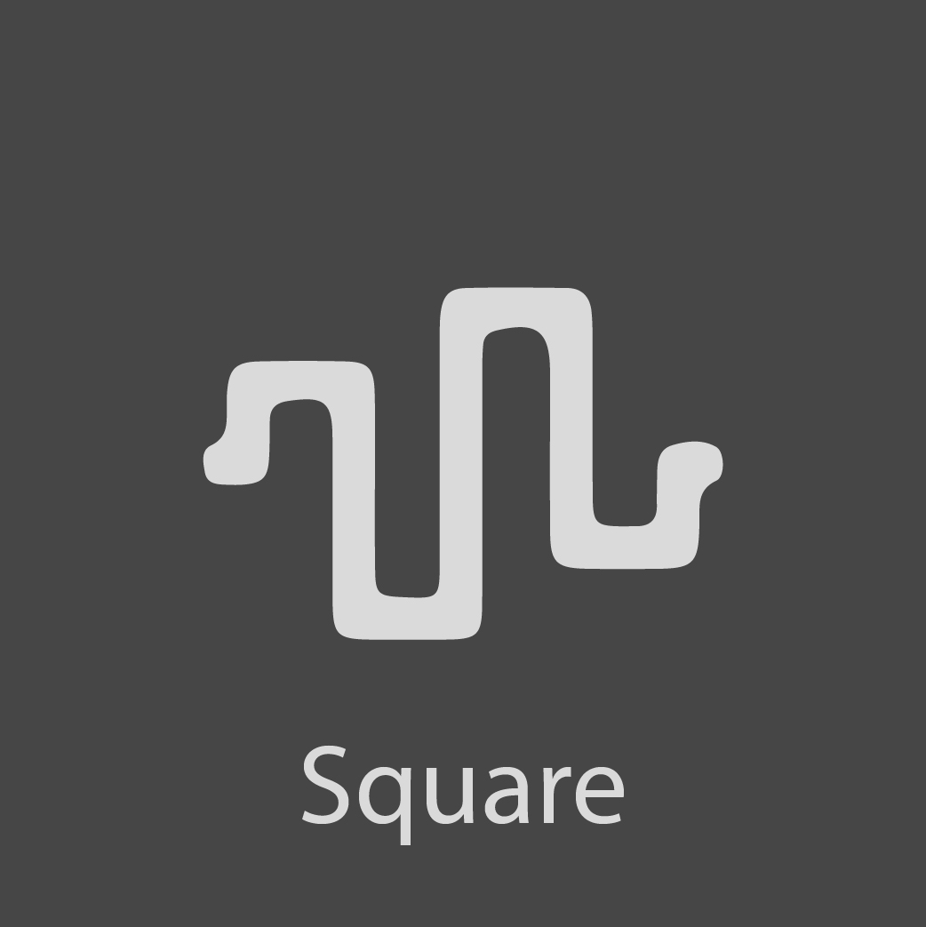

Oscillator
Filters
Envelope
Generator
SUBTRACTIVE SYNTHESIS

Slide 4
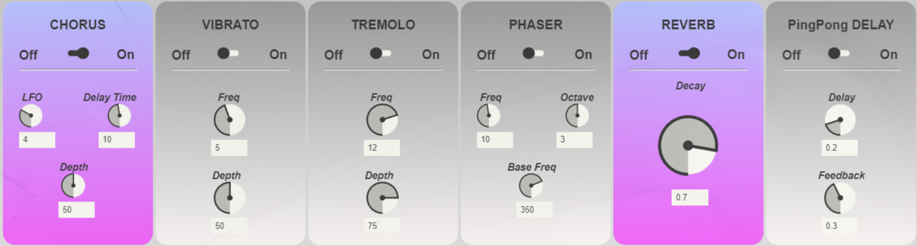
EFFECTS
can be played simultaneously
visual identity of the block changes depending on the state (on / off)

Slide 5
EFFECTS
CHORUS
one of the most popular phase modulation effects
meant to simulate the subtle pitch and timing differences that occur when multiple musicians play the same note but vary slightly in pitch and timing
VIBRATO
modulation effect that varies pitch
sense of movement and rhythm are created as the pitch cyclically goes up and down
TREMOLO
creates movement and rhythm by varying the amplitude of the signal
particularly useful for creating percussive shuddering or stuttering
PHASER
combines the original signal with a copy that is slightly out of phase with the original
amplitudes of the two signals reach their highest and lowest points at slightly different times
REVERB
adds reverberation
PING-PONG DELAY
stereo feedback delay where the delay bounces back and forth

Slide 6
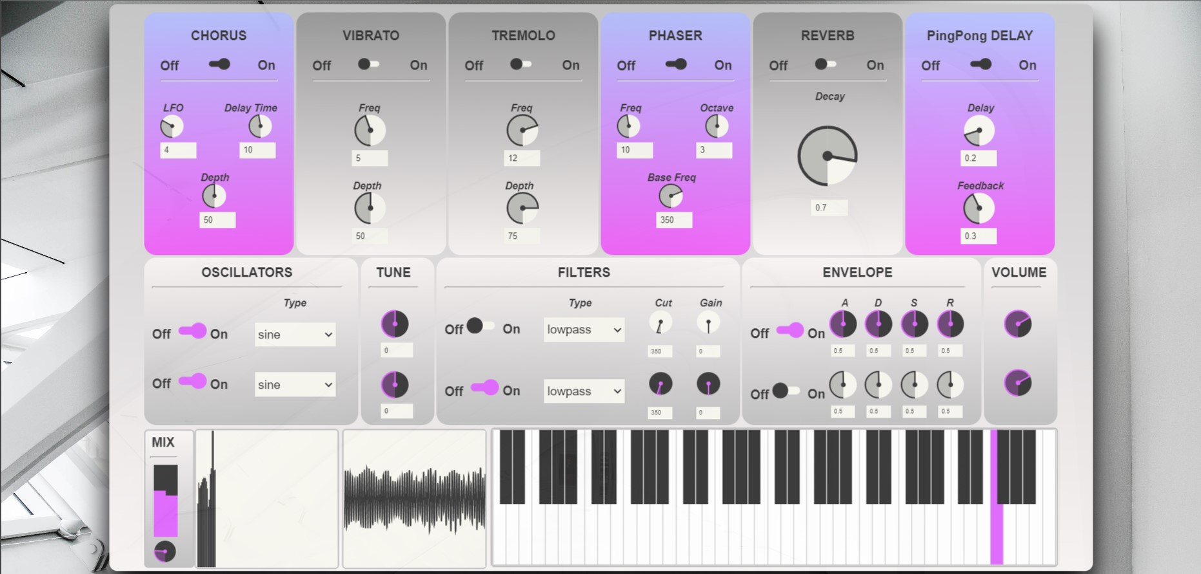
GRAPHICAL USER INTERFACE

Slide 7
Thank you for the attention!
Natasa Popovic, 991034
Olga Besedova
Andres Bertazzi

